Slide 1

Name: Douglas
Course: Intro to computer and Tech
Section Number:21/SP – CGS – 1000- 48076

Slide 2

Planning a concert
Important tips for concert planning
In order to have a successful concert, planning is very important. As a musician, your fans deserve an exhilarating experience through seeing you performing live at a music concert, and this is only possible by careful planning of the concert To plan a concert, it is important to put into consideration certain factors such as;

Slide 3

Factors to consider while planning a concert
the concert venue
budget
concert promotion
logistics
ticket pricing
talent buying

Slide 4
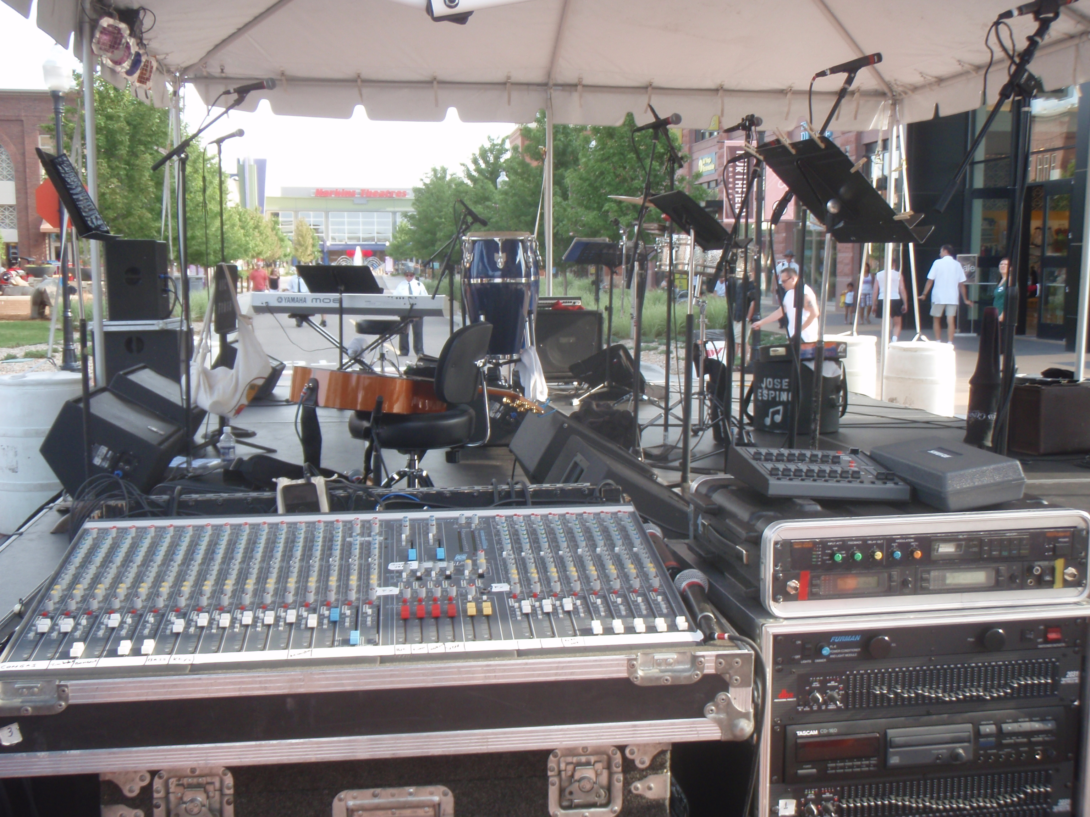
Budget
For a successful concert, a well-planned budget should be at hand to cater for the expenses. Such expenses include talent buying, preparing the venue, renting lighting and sound speakers, infrastructure, concert promotion etc.

Slide 5
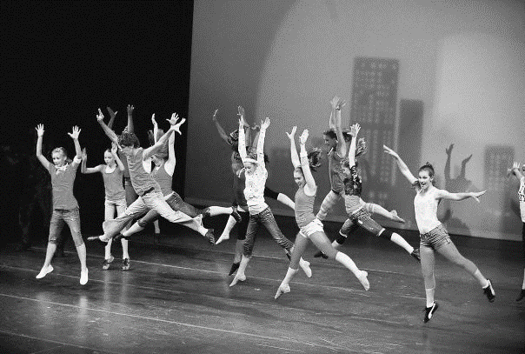
Talent buying
It is good to consider the interests and likes of the audience. One should get the best performers for their audience.

Slide 6

Prepare the venue
Factors such as the distance to the venue, availability of parking and the traffic should be considered. Make sure the venue accommodates all the attendees the location of the venue should also be made clear on social media platforms so as to enable the attendees get there easily

Slide 7
Finalizing on the dates
Decide on the exact dates for the concert and share it with the audience and other stake holders.

Slide 8
Logistics
This includes getting the right equipment such as microphones, stage lighting,mixing boards etc. CCTV surveillance is also crucial. Other factors include food arrangements and a dressing room

Slide 9
Concert promotion
Concert promotion involves marketing and making people aware of your concert. One should aim at reaching out to as many people as possible. There are different ways to do concert promotion which include; social media platforms or even using social media influencers to promote the concert, contracting a music PR agency to do the promotion or even using online event platforms e.g Eventbrite.

Slide 10
The tips discussed on planning a concert are very crucial for any successful concert. The audience should be the central factor when looking for the performers in a concert. Furthermore, the stakeholders should be consulted when planning for a concert.

Slide 11
Concert Expenses
Expense | Cost ($)
Talent buying | 500
Transport | 200
Concert promotion | 150
Rent (lighting and sound speakers) | 400
Total cost | 1250

